Slide 1
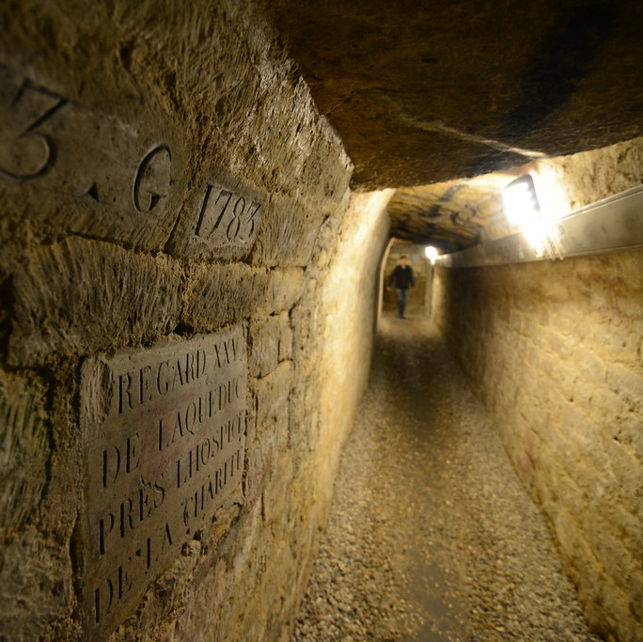
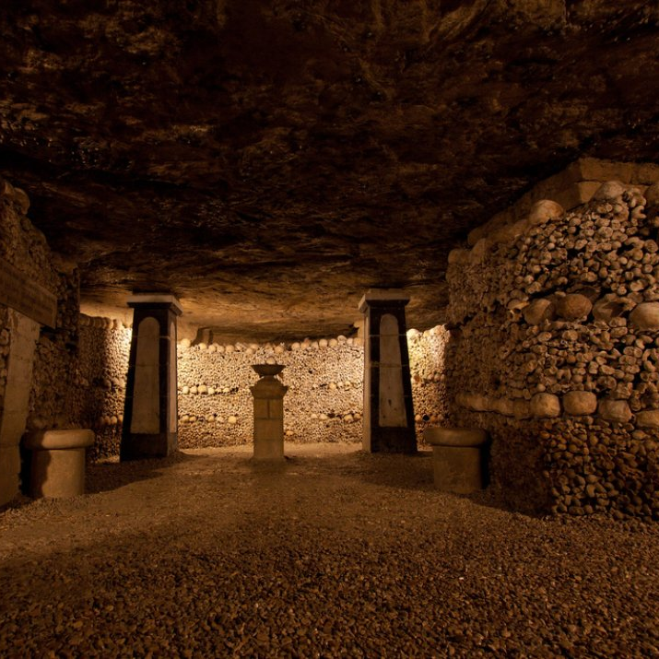
The Catacombs By: Karaline Layton & Annum Islam
A horror-based text adventure. Can you escape the catacombs before the monster gets you…
This Photo by Unknown Author is licensed under CC BY
This Photo by Unknown Author is licensed under CC BY

